Slide 1
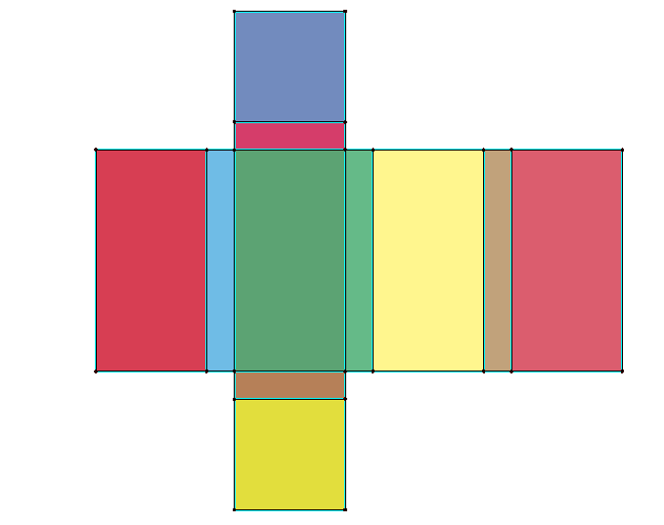
Box geometry
7
6
1
2
3
8
9
10
11
y
x
5
4

